Slide 1

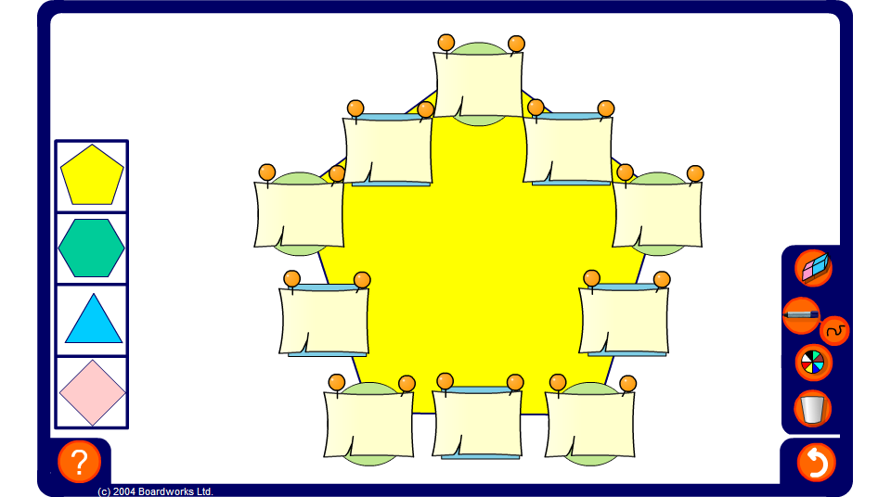


Arithmagons – two significant figures
Notes:
Use the arithmagon on this slide to practise adding and subtracting numbers of the same magnitude written to two significant figures (including negative numbers). Press reset for a new puzzle or change the shape of the puzzle by selecting one of the shapes on the left.

